Slide 1
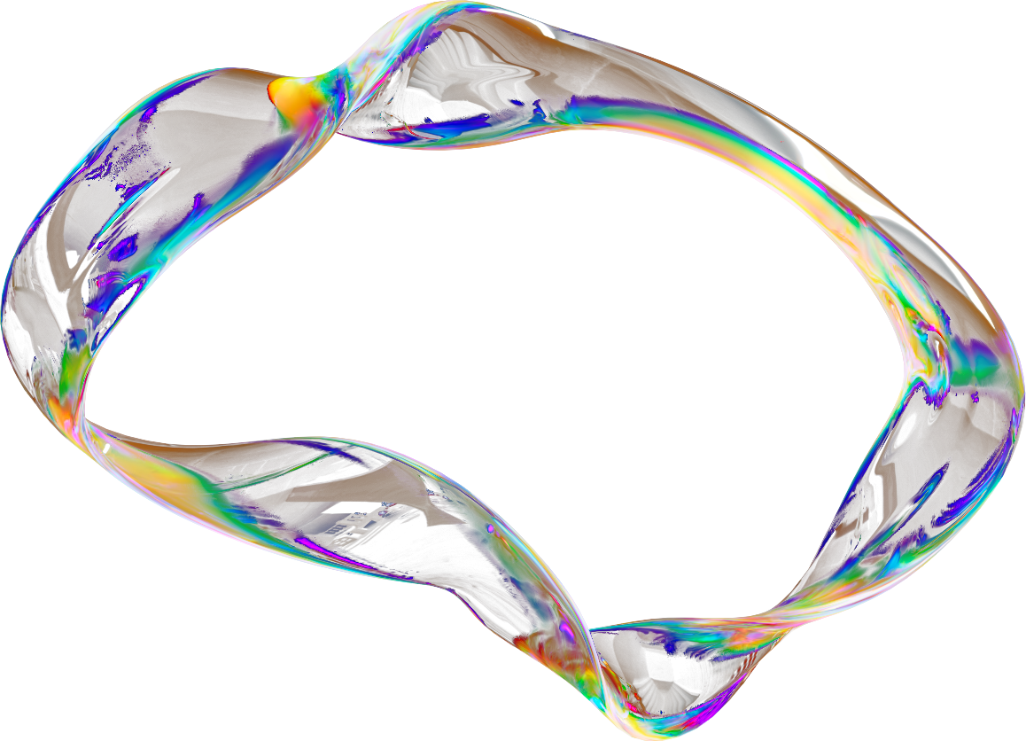
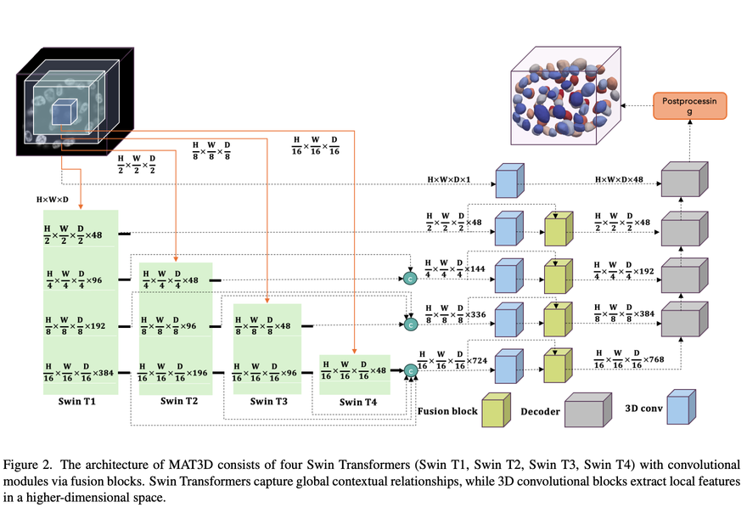
MULTI-APERTURE TRANSFORMERS FOR 3D (MAT3D) SEGMENTATION OF CLINICAL AND MICROSCOPIC IMAGES
Authors: Muhammad Sohaib, Siyavash Shabani, et al. (University of Nevada, Reno)
Problem Addressed: The challenge of perfectly separating and segmenting complex, clumped 3D biological structures (e.g., cell nuclei, cardiovascular chambers).
Proposed Solution: A novel 3D segmentation framework that integrates the global context-awareness of Transformer networks (like SwinUNETR) with the local feature extraction of Convolutional Neural Networks (CNNs).
Core Contribution: It uses a unique "Multi-Aperture" approach to capture details across different receptive fields, achieving high precision in dense 3D volumes.
Om Kumar (b23bb1030)
Iha Goyal (b23bb1020)

Slide 2
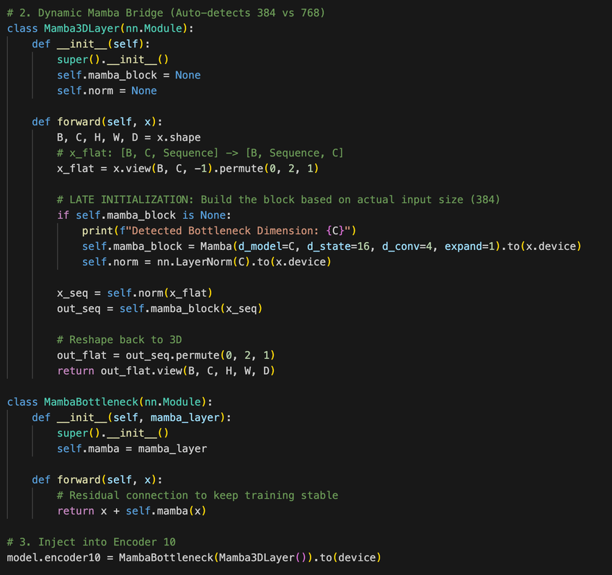
OUR APPROACH AND SPECIFIC CONTRIBUTIONS
Baseline Reproduction: Engineered an automated MLOps pipeline to convert 300 raw ACDC HDF5 volumes to NIfTI, successfully reproducing the MAT3D framework.
Identified Flaw: Standard Vision Transformers (Swin) rely on localized windowed attention, creating an O(N²) memory bottleneck that restricts continuous 3D spatial awareness.
Our Novel Solution (The "Extra"): We developed the MAT-Mamba Hybrid architecture. We performed "architectural surgery" to replace the Swin-T4 bottleneck with a Linear-Time State-Space Model (Mamba).
Dynamic Mamba Bridge: Wrote a custom Mamba3DLayer with a residual connection (x + Mamba(x)) to efficiently flatten 3D data, capturing global anatomical context at O(N) efficiency.

Slide 3
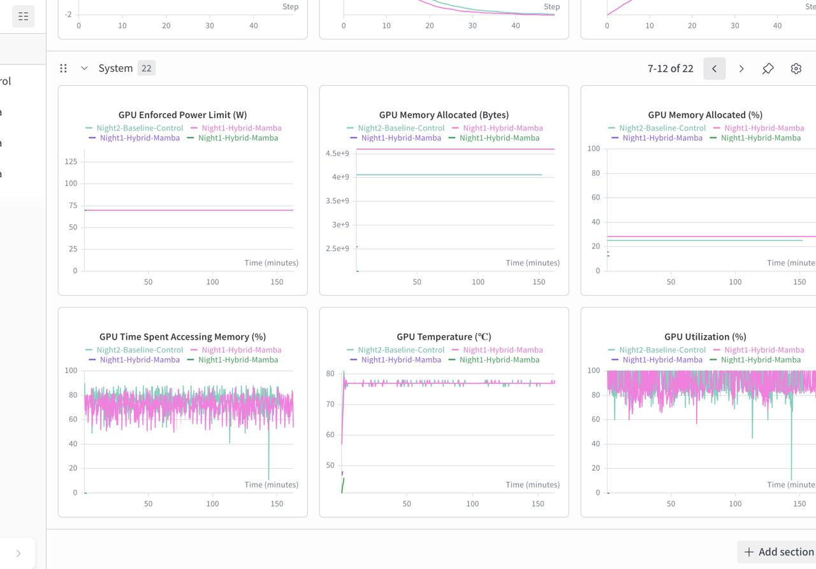
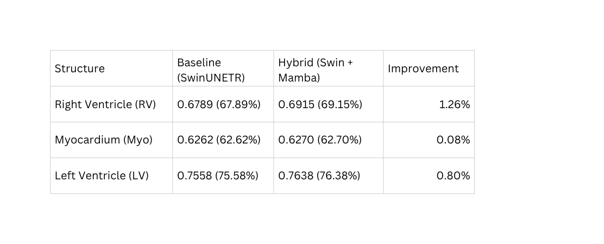
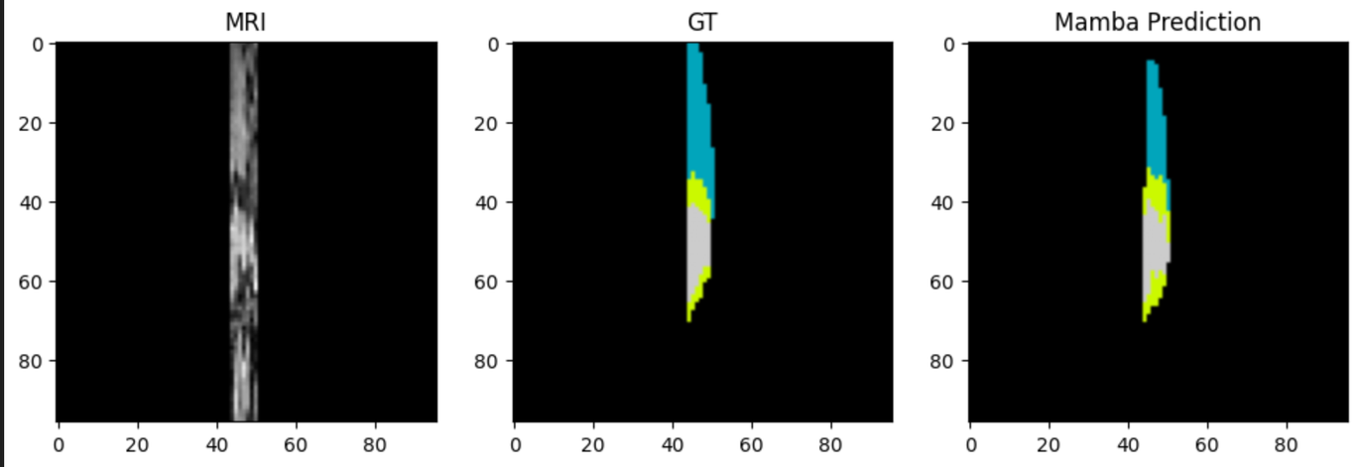
EXPERIMENTAL RESULTS
Dataset: ACDC Dataset (300 volumes) | Split: 210 Train / 60 Val / 30 Test
Computational Efficiency:
WandB profiling proves the linear-time Mamba block bypassed the O(N^2) attention bottleneck, improving accuracy with only a ~0.5GB VRAM increase and identical training time (150m).
The Mamba Advantage
Overcoming Localized Limits: Standard Swin blocks rely on windowed attention, restricting the ability to track continuous 3D shapes.
Global Sequence Scanning: Our hybrid network utilizes a Linear-Time State-Space Model to dynamically scan the entire 3D volume without local constraints.
Sharper Boundaries: Mamba effectively "remembers" global context, driving significant improvements in structurally complex regions like the Right Ventricle.
Qualitative output demonstrating MAT-Mamba accurately delineating complex cardiovascular structures.

Slide 4


Iha Goyal (b23bb1020)
Ideation & Novelty: Spearheaded the literature review, selected the base MAT3D paper, and conceptualized the novel MAT-Mamba hybrid architecture.
Core Architecture: Engineered the custom PyTorch models, successfully implementing the Mamba3DLayer and MambaBottleneck into the Encoder.
Model Training: Managed the GPU mixed-precision training logic, debugging, and configured the Weights & Biases (WandB) tracking environment.
Project Deliverables: Coordinated the project documentation for the Phase 2 report.
Om Kumar (b23bb1030)
INDIVIDUAL TEAM MEMBER’S CONTRIBUTION
Data Engineering: Managed dataset acquisition and preprocessing,
Evaluation Scripts: Assisted in writing the supporting evaluation scripts to calculate the final Dice scores and generate the qualitative MRI visual outputs.
Qualitative Analysis & Visualization: Developed the inference to generate high-resolution, side-by-side anatomical comparisons of MRI slices, Ground Truth masks, and model predictions for visual validation.
Project Deliverables: Coordinated the project documentation, structuring the data for the final presentation.

Slide 5
THANK YOU

